Slide 1
Introduction into HTML
Pengembangan Berbasis Platform
Semester Gasal
2018/2019

Slide 2
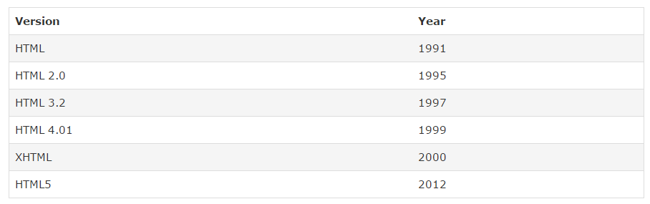
What is HTML?
HTML stands for Hyper Text Markup Language
HTML is a markup language for describing web documents (web pages).
A markup language is a set of markup tags
Each HTML tag describes different document content

Slide 3
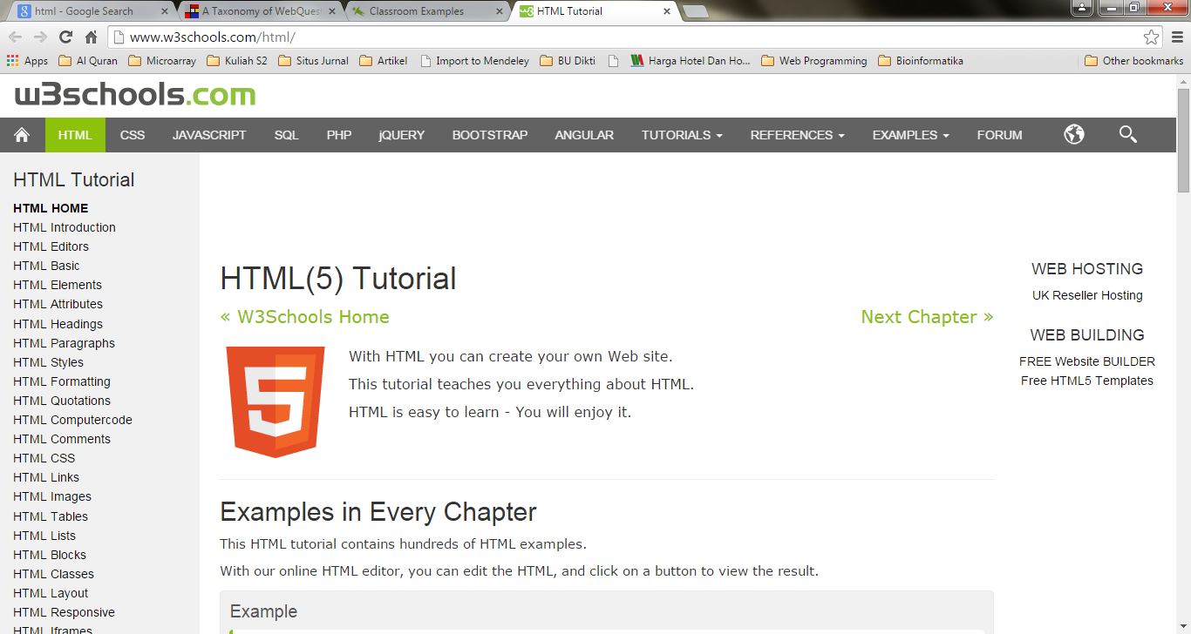
Sources to Study HTML
www.w3school.com/html

Slide 4
HTML Example

Slide 5
HTML Example (2)
The DOCTYPE declaration defines the document type to be HTML
The text between <html> and </html> describes an HTML document
The text between <head> and </head> provides information about the document
The text between <title> and </title> provides a title for the document
The text between <body> and </body> describes the visible page content
The text between <h1> and </h1> describes a heading
The text between <p> and </p> describes a paragraph
Using this description, a web browser can display a document with a heading and a paragraph.

Slide 6
HTML Tags
HTML tags are keywords (tag names) surrounded by angle brackets: <tagname>content</tagname>
HTML tags normally come in pairs like <p> and </p>
The first tag in a pair is the start tag (opening tag), the second tag is the end tag (closing tag)
The end tag is written like the start tag, but with a slash before the tag name.
HTML tags are not case sensitive: <P> means the same as <p>.
W3C recommends: lowercase.

Slide 7
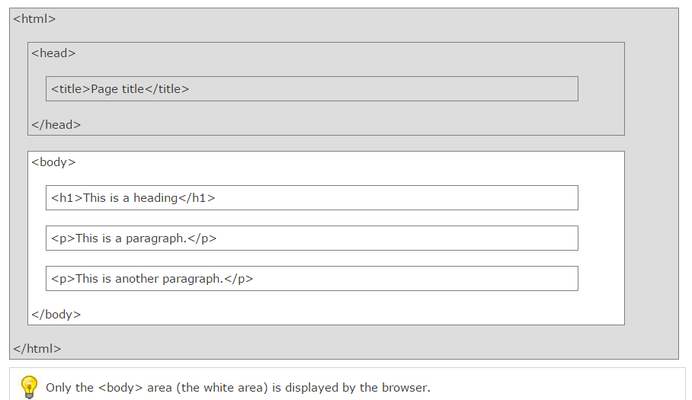
HTML Page Structure

Slide 8
The <!DOCTYPE> Declaration
The <!DOCTYPE> declaration helps the browser to display a web page correctly.
To display a document correctly, the browser must know both type and version.
The doctype declaration is not case sensitive. All cases are acceptable:
<!DOCTYPE html> <!DOCTYPE HTML> <!doctype html> <!Doctype Html>

Slide 9
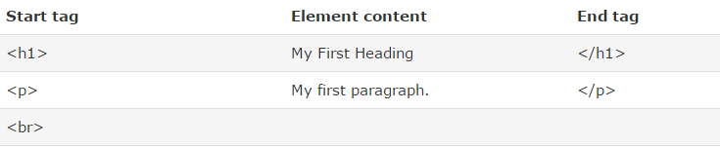
HTML Elements
HTML elements are written with a start tag, with an end tag, with the content in between:
<tagname>content</tagname>
The HTML element is everything from the start tag to the end tag:
<p>My first HTML paragraph.</p>
Some HTML elements do not have an end tag.

Slide 10
Nested HTML Elements
HTML elements can be nested (elements can contain elements).
All HTML documents consist of nested HTML elements.
This example contains 4 HTML elements:
<!DOCTYPE html> <html> <body> <h1>My First Heading</h1> <p>My first paragraph.</p> </body> </html>

Slide 11
HTML Elements
The <html> element defines the whole document.
It has a start tag <html> and an end tag </html>.
The element content is another HTML element (the <body> element).
The <body> element defines the document body.
It has a start tag <body> and an end tag </body>.
The element content is two other HTML elements (<h1> and <p>).

Slide 12
Don't Forget the End Tag
Some HTML elements will display correctly, even if you forget the end tag:
The example above works in all browsers, because the closing tag is considered optional.
Never rely on this. It might produce unexpected results and/or errors if you forget the end tag.
<html> <body> <p>This is a paragraph <p>This is a paragraph </body> </html>

Slide 13
Empty HTML Elements
HTML elements with no content are called empty elements.
<br> is an empty element without a closing tag (the <br> tag defines a line break).
Empty elements can be "closed" in the opening tag like this: <br />.
HTML5 does not require empty elements to be closed. But if you want stricter validation, or you need to make your document readable by XML parsers, you should close all HTML elements.

Slide 14
HTML Attributes
Attributes provide additional information about HTML elements.
HTML elements can have attributes
Attributes are always specified in the start tag
Attributes come in name/value pairs like: name="value"
The HTML5 standard does not require lower case attribute names.
The title attribute can be written with upper or lower case like Title and/or TITLE.
W3C recommends : Always Use Lowercase Attributes

Slide 15
HTML Attributes
W3C recommends : Always Quote Attribute Values
The HTML5 standard does not require quotes around attribute values.
Sometimes it is necessary to use quotes. This will not display correctly, because it contains a space:
<p title=About W3Schools>
Double style quotes are the most common in HTML, but single style can also be used.
In some situations, when the attribute value itself contains double quotes, it is necessary to use single quotes:
<p title='John "ShotGun" Nelson'>
<p title="John 'ShotGun' Nelson">

Slide 16
HTML(5) Style Guide and Coding Conventions
Use Correct Document Type, ex: <!DOCTYPE html>
Use Lower Case Element Names
<section> <p>This is a paragraph.</p> </section>
Close All HTML Elements
Close Empty HTML Elements, example: <br />
Use Lower Case Attribute Names and quote Attribute Values
<table class="table striped">

Slide 17
HTML(5) Style Guide and Coding Conventions
Image attributes:
Always use the alt attribute with images. It is important when the image cannot be viewed.
<img src="html5.gif" alt="HTML5" style="width:128px;height:128px">
Spaces and equal signs
<link rel="stylesheet" href="styles.css">
Use lower case file names and .html extension (not .htm).

Slide 18
Some HTML Elements
Heading
Paragraph
Pre
Link
Image

Slide 19
HTML Headings
HTML headings are defined with the <h1> to <h6> tags:
<h1>This is a heading</h1> <h2>This is a heading</h2> <h3>This is a heading</h3>
The <hr /> tag creates a horizontal line in an HTML page.

Slide 20
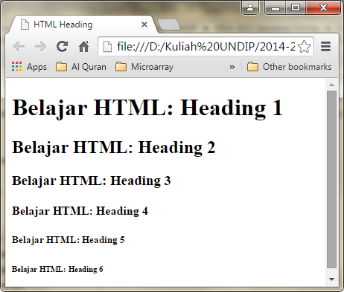

Slide 21
HTML Paragraphs
HTML paragraphs are defined with the <p> tag:
<p>This is a paragraph.</p> <p>This is another paragraph.</p>
The browser will remove extra spaces and extra lines when the page is displayed.
Any number of spaces, and any number of new lines, count as only one space.
Use <br /> if you want a line break (a new line) without starting a new paragraph:

Slide 22
The HTML <pre> Element
The HTML <pre> element defines preformatted text.
The text inside a <pre> element is displayed in a fixed-width font (usually Courier), and it preserves both spaces and line breaks:
<pre> My Bonnie lies over the ocean. My Bonnie lies over the sea. My Bonnie lies over the ocean. Oh, bring back my Bonnie to me. </pre>

Slide 23
HTML Links
HTML links are defined with the <a> tag:
The link address is specified in the href attribute.
Attributes are used to provide additional information about HTML elements.
<a href="http://www.w3schools.com">This is a link</a>

Slide 24
HTML Links(2)
The target attribute specifies where to open the linked document.
This example will open the linked document in a new browser window or in a new tab:
<a href="http://www.w3schools.com/" target="_blank">Visit W3Schools!</a>
The id attribute can be used to create bookmarks inside HTML documents.
Add an id attribute to any <a> element:
<a id="tips">Useful Tips Section</a>
Then create a link to the <a> element:
<a href="#tips">Visit the Useful Tips Section</a>

Slide 25
HTML Images
Images are defined with the <img> tag.
The <img> tag is empty, it contains attributes only, and does not have a closing tag.
<img src="url" alt="some_text">
The src attribute defines the url (web address) of the image.
The alt attribute specifies an alternate text for the image, if it cannot be displayed.

Slide 26
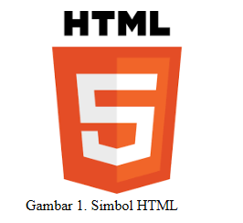

Slide 27
HTML Images (cont.)
Image Width and Height
Using style attribute.
The values are specified in pixels (use px after the value):
<img src="html5.gif" alt="HTML5 Icon" style="width:128px;height:128px">
Using width and height attributes.
The values are specified in pixels (without px after the value):
<img src="html5.gif" alt="HTML5 Icon" width="128" height="128">

Slide 28
HTML Images (cont.)
Images in Another Folder
<img src="/images/html5.gif" alt="HTML5 Icon" style="width:128px;height:128px">
Images on Another Server
<img src="http://www.w3schools.com/images/w3schools_green.jpg">

Slide 29


HTML Images (cont.)
Using an Image as a Link

Slide 30
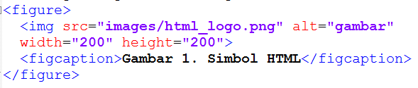
HTML Images (cont.)
Elemen <img> dapat pula di-mark up ke dalam elemen <figure></figure> dan memiliki figur caption <figcaption></figcaption>.

Slide 31
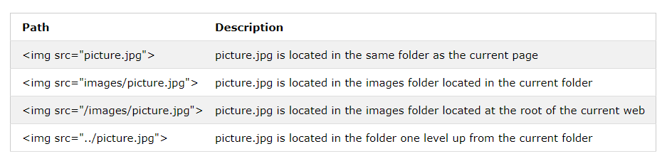
HTML File Path
An absolute file path is the full URL to an internet file.
<img src="https://www.w3schools.com/images/picture.jpg" alt="Mountain">
A relative file path points to a file relative to the current page.

Slide 32
HTML File Path (cont.)
Best practice
It is a best practice to use relative file paths (if possible).
When using relative file paths, your web pages will not be bound to your current base URL. All links will work on your own computer (localhost) as well as on your current public domain and your future public domains.

